Slide 1
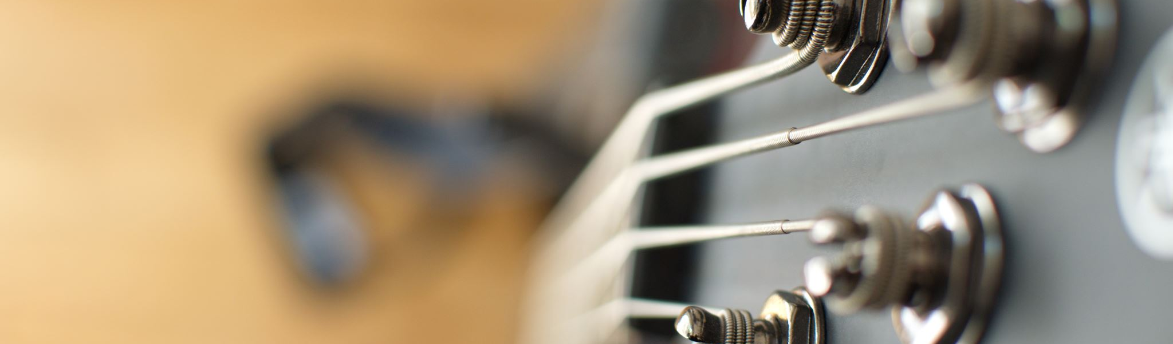
An Exploration into Music Venues
Rebecca Levine
Matt Kukulski
Pauly Richmeier
Charles Stephens

Slide 2
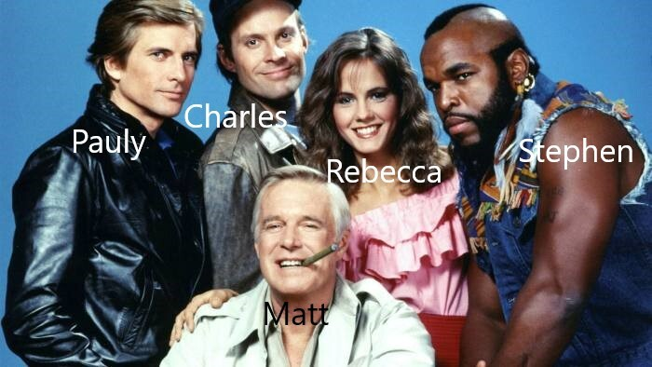
The A-Team

Slide 3
Motivation
Sick of 2020
Wanted lighthearted topics that took us back to the “good ol’ Pre Covid Days”
All love music
Wanted to see what factors into a music venue’s success

Slide 4
Our Questions
Is there a correlation to a music venue’s rating and its offering of food and alcohol?
Do music venues experience seasonal fluctuations in popularity based on indoor and outdoor setting?
Is there a correlation between the price of the offered servings and rating of venue?

Slide 5
Exploration and Problems
Started with Google Places
Only provide 5 reviews total
SoundKick was next
Never got an API key
PollStar
Had info we needed – LARGE cost
OutScraper

Slide 6
Do music venues experience seasonal fluctuations in popularity based on indoor and outdoor setting?
Used OutScraper
Needed number of reviews and ratings for each season between 2018 and 2019
Winter (January-March)
Spring (April-June)
Summer (July-September)
Fall (October-December)

Slide 7
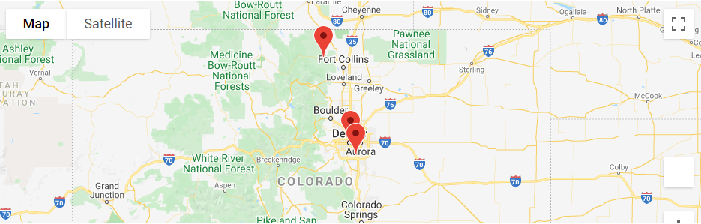
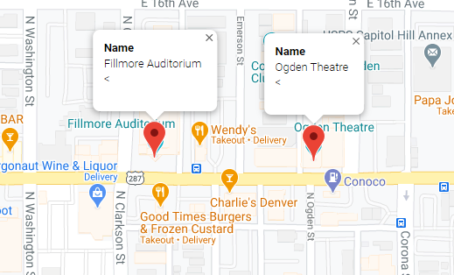
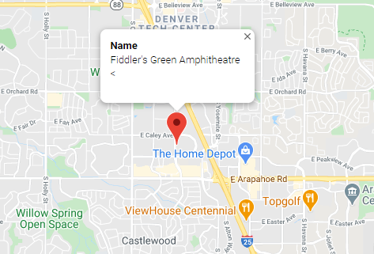
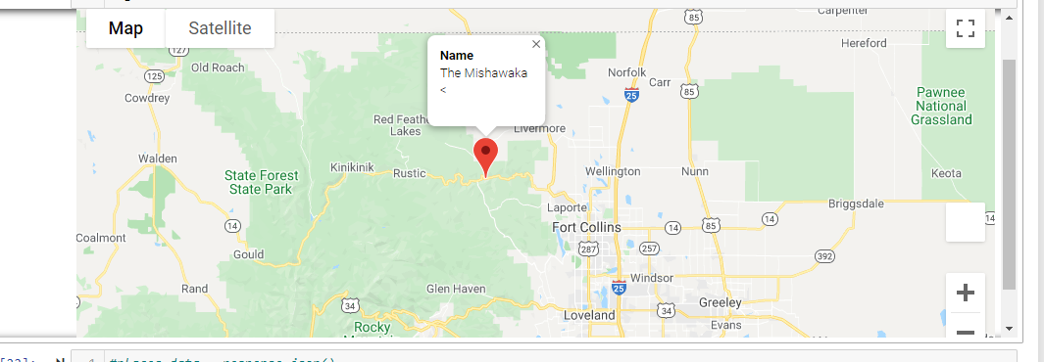

Slide 8
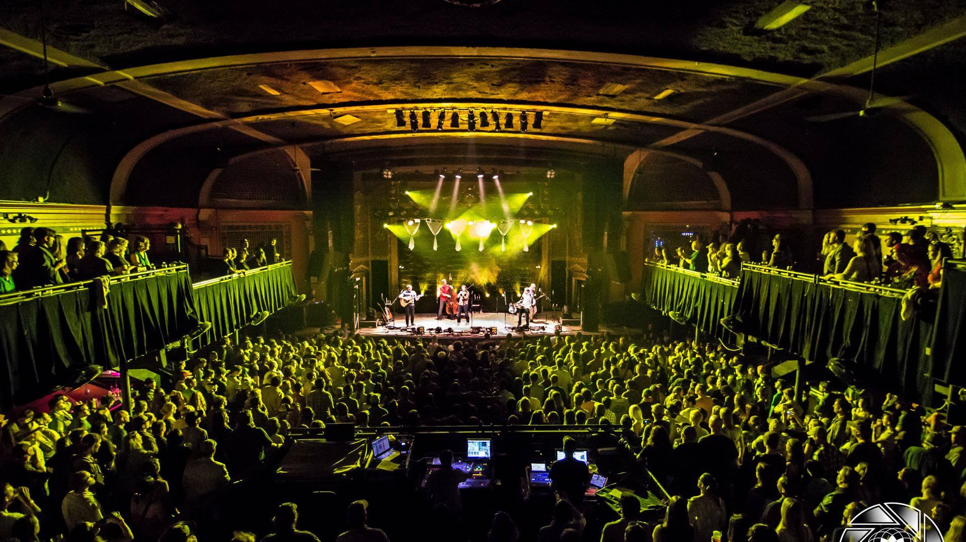
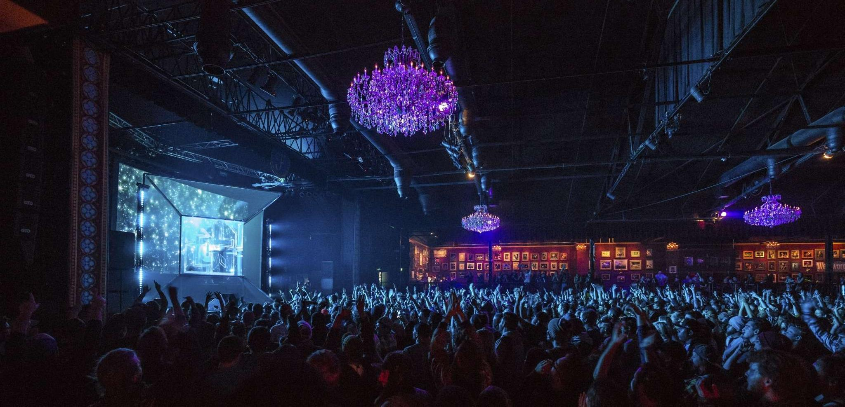
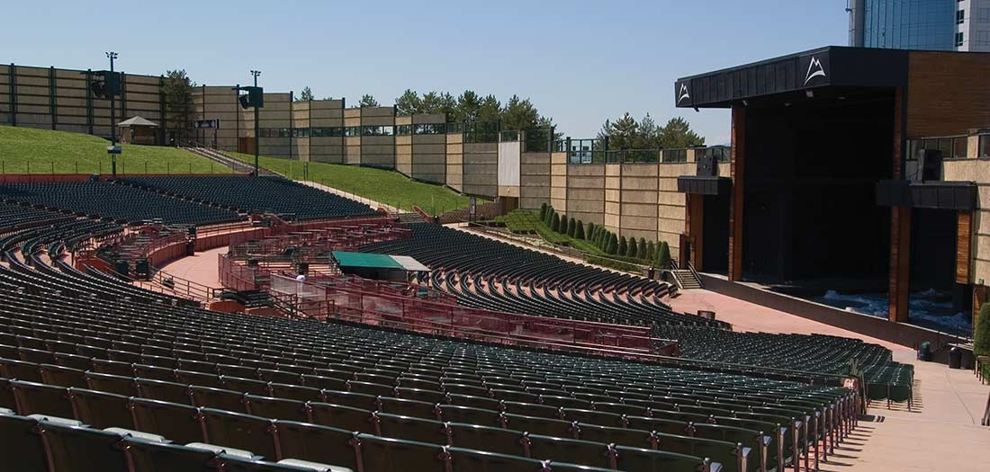
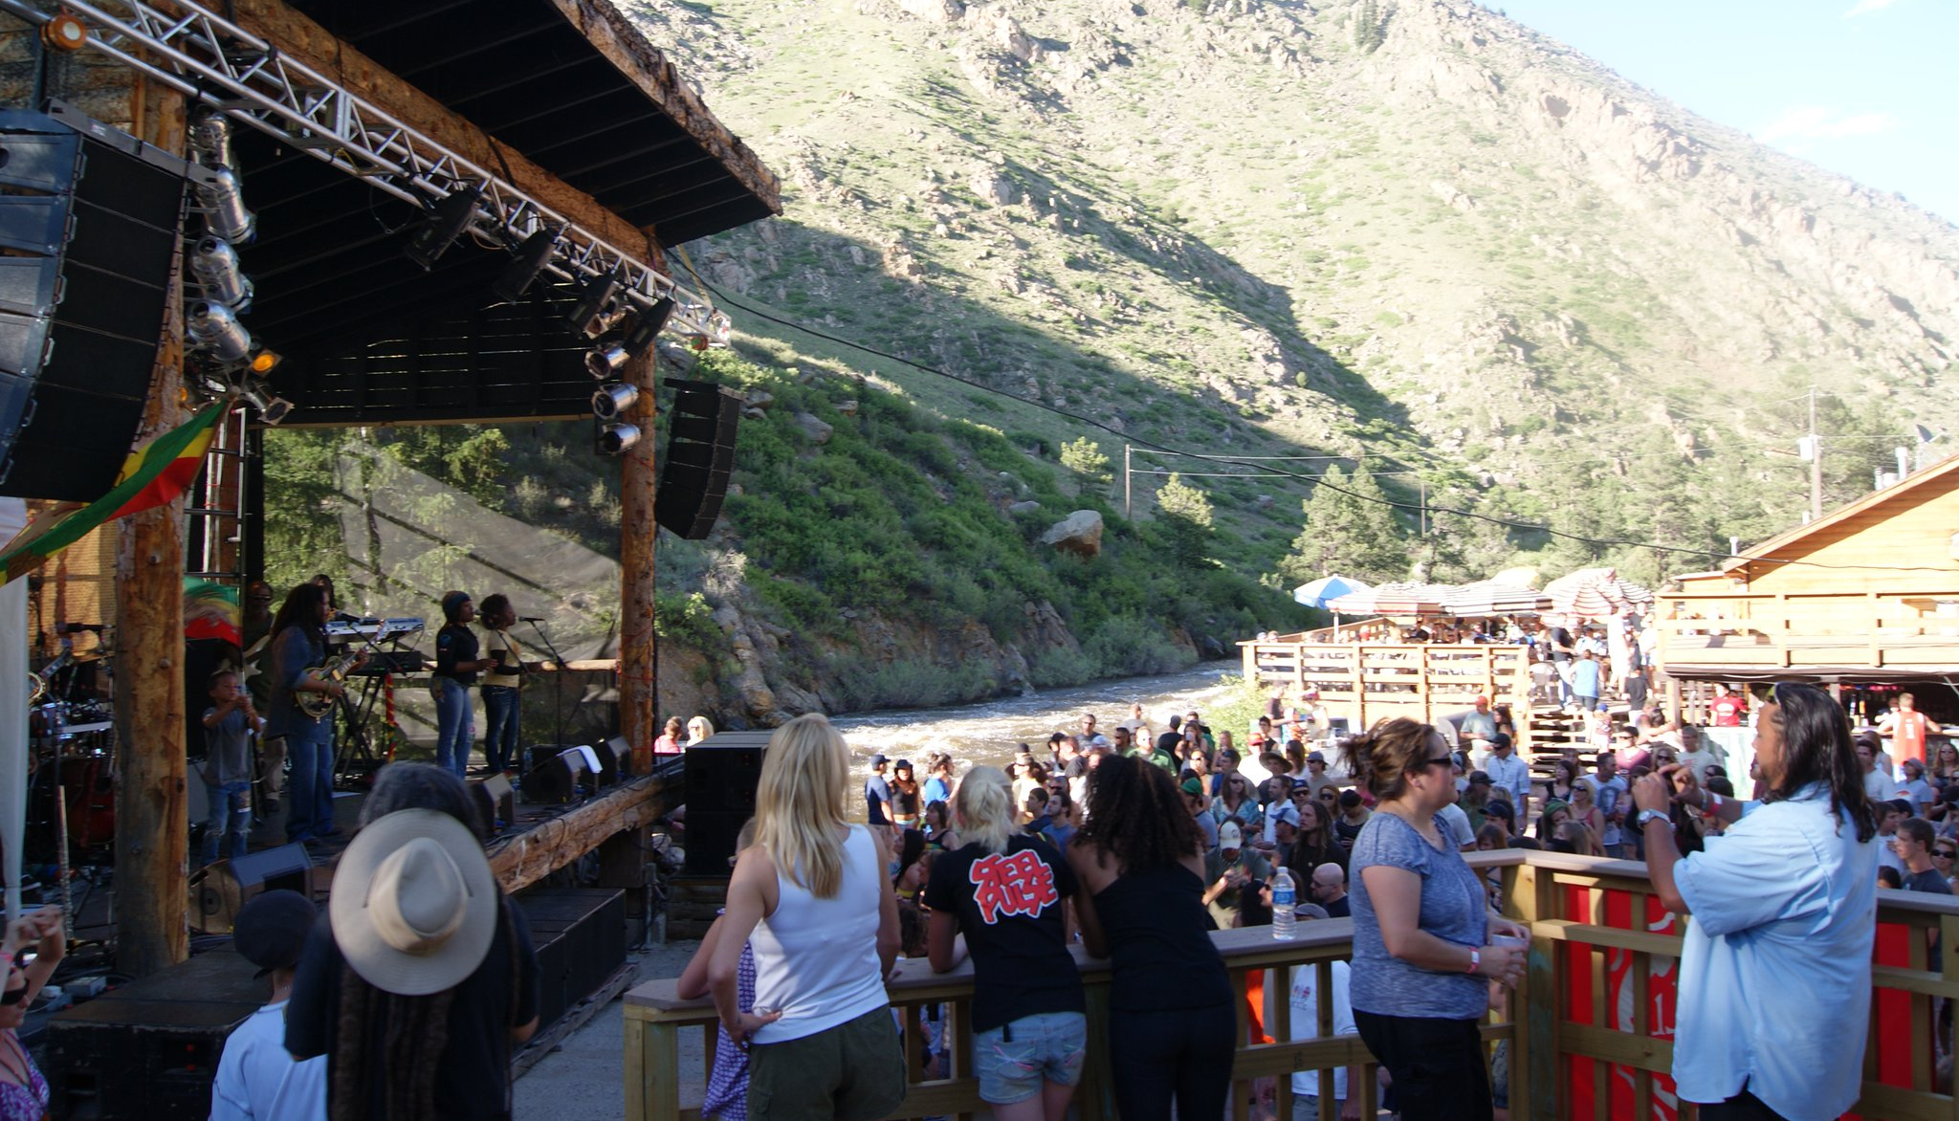

Slide 9
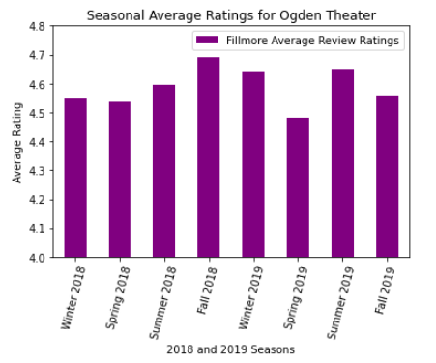
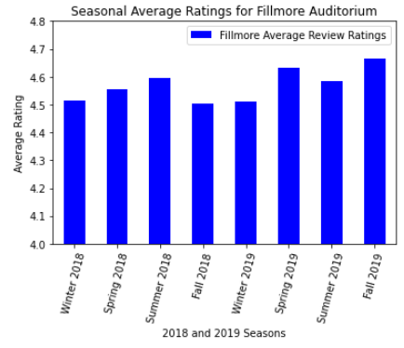
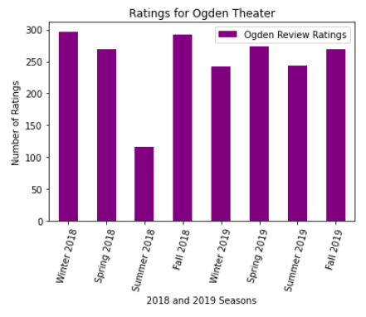
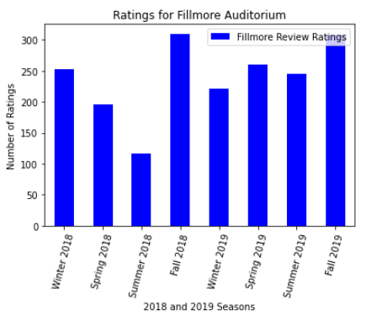
Indoor Venues
https://github.com/mattyk33/A-team/blob/main/Untitled.ipynb

Slide 10
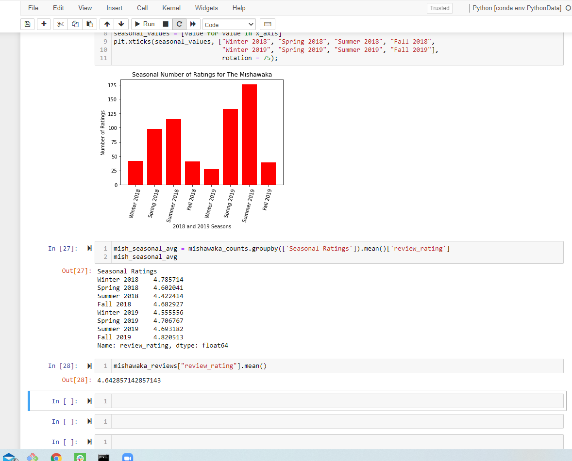
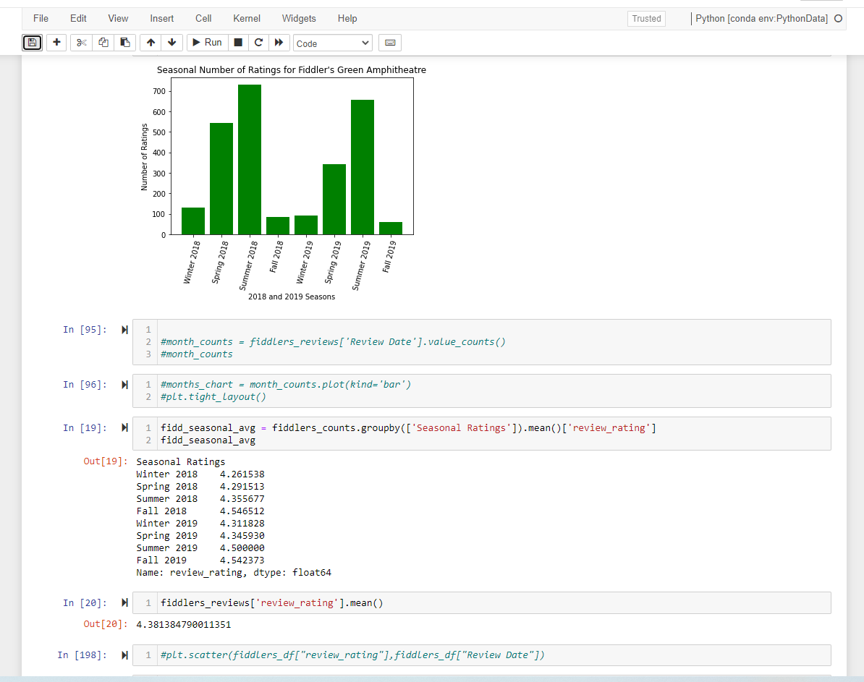
Outdoor Venues
https://github.com/mattyk33/A-team/blob/main/ATeamProjectPy.ipynb
The Mishawaka
Fiddler’s Green

Slide 11
Exploration and Problems
Yelp API pull was tricky to figure out
Only could pull 50 venues at a time
Had to offset and append
Couldn’t figure out if a venue served food and/or drinks

Slide 12
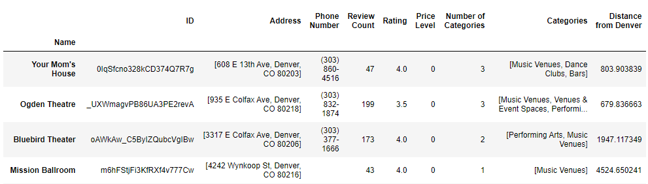
Is there a correlation between the price of the offered servings and rating of venue?
Yelp API
Needed: Music Venues, Rating, Price Level
Used Denver as the location, and searched for Music Venues within 20,000 meters (just under 12.5 miles) radius

Slide 13
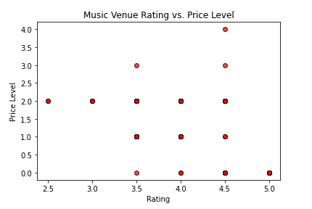
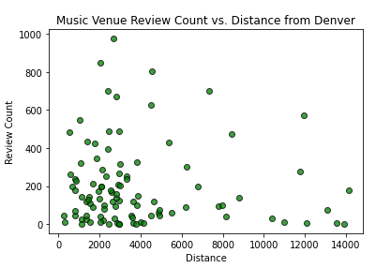
rvalue=-0.3812416051679814
rvalue=-0.06332500699184733
https://github.com/mattyk33/A-team/blob/main/Yelp_API_Pull.ipynb

Slide 14
Is there a correlation to a music venue’s rating and its offering of food and alcohol?
Not enough data to dig deep into this.
There was a significant difference between two venues ratings, but we didn’t have more venues to see if the trend stuck.
Mishawaka
Fiddler’s Green

Slide 15
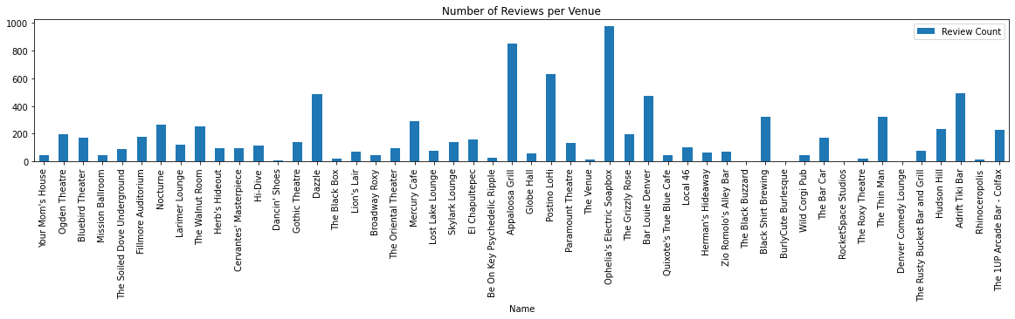
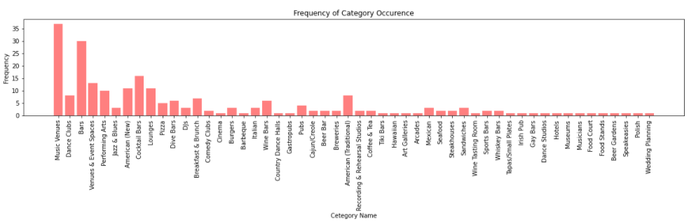

Slide 16
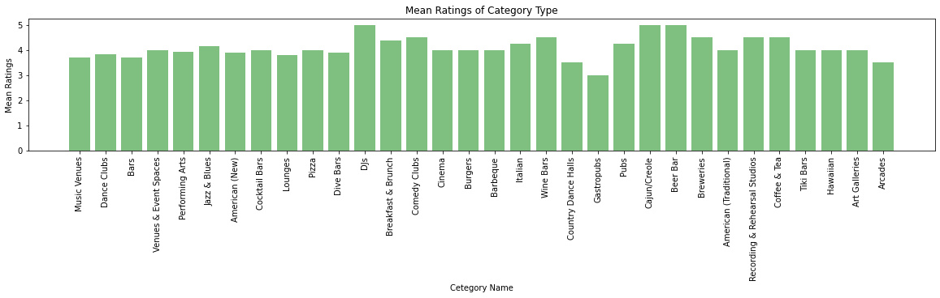
https://github.com/mattyk33/A-team/blob/main/yelp_music_venue_reviews2.ipynb

Slide 17
Conclusions
Had to change one question to look more towards categories
Needs further analysis
Season does have some influence on number of reviews
Rating stays consistent throughout the year
No correlation between price level and venue rating
Proximity to Denver has no impact on number of reviews a venue receives

